Slide 1
Project Review
20pd10 Shakthi Mahendira K

Slide 2
Special Thanks
Dr. R. Nadarajan, Director,
Department of Applied Mathematics and Computational Sciences, PSG College of Technology.
Dr. Shina Sheen, Head of the Department,
Department of Applied Mathematics and Computational Sciences, PSG College of Technology.
Dr. M. Senthil Kumar, Course Coordinator,
Department of Applied Mathematics and Computational Sciences, PSG College of Technology.
Mrs M Kashthuri Bai, Tutor,
Department of Applied Mathematics and Computational Sciences, PSG College of Technology.
Ms S S. Sudha, Academic Guide,
Department of Applied Mathematics and Computational Sciences, PSG College of Technology.
Mr Ratnayash Pandey, External Guide,
Project Manager at TVS Digital Pvt. Ltd.

Slide 3
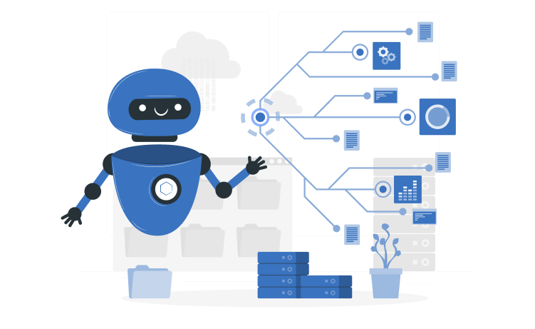
Contents
About - TVS Digital
Internship Overview
Work Done
Timeline
Tools and Technology Used

Slide 4

About - TVS Digital
Founded in May 2021, TVS Digital is a Singapore-headquartered company delivering innovative solutions for the Automotive and Financial Services industries using cutting-edge technologies. The company operates across ASEAN and South Asia, with a growing global presence and a team of over 200 professionals.
Key Offerings:
• Products: Autotech & Fintech platforms that have evolved and scaled over the past three years.
• Services: Implementation and support for industry-leading platforms like Salesforce.
Certifications & Compliance:
• ISO27001 & APEC Data Privacy Certification for security and credibility.
• VAPT Certified by reputed assessors in Singapore.
Core Values:
• Trust, Passion, and Respect for customers & employees.
• Innovation @ Speed with a focus on continuous learning.
• Empowerment, open communication, and customer-centric solutions.
TVS Digital is rapidly scaling its services business in India while expanding into new geographies, driving profitable growth with a high-performance team.
Website: www.tvsd.ai
Headquarters: Singapore
Founded: 2021
Specialties: Automotive, Fintech, Software, Data Science, UX/UI, SaaS/PaaS, and Program Management

Slide 5
Hardware Specifications
Processor - intel i7 10th Gen
Ram- 16GB
Software Specifications
OS Windows 11

Slide 6
Internship Overview
Joined TVS Digital as a Data Science Intern in December 2024. • Worked on two key projects:
AI Chatbot – Built a Sales Copilot using RAG with the Gemini Flash LLM.
Rule-Based + AI Chatbot – Developed a ticket resolution L0 chatbot that combines Rule-based logic with RAG using the Gemini Flash LLM.

Slide 7
Project 1 – Sales Copilot
Objective: Develop a Sales Copilot to assist sales personnel. In showrooms, there are often new hires, making it challenging to train them on vehicle details and other essential information. An AI-powered assistant can be installed to help sales personnel quickly access and provide accurate information to customers, enhancing their efficiency and customer experience

Slide 8
Handling Structured Data Queries
User Input: Query requiring structured data (e.g., “Show sales in Q1 2024”)
Database Schema Awareness: LLM is prompted with the database schema
SQL Query Generation: Gemini LLM generates an optimized SQL query
Query Execution: SQL is executed on the database
Response Generation: Retrieved data is formatted and presented to the user

Slide 9
Handling Unstructured Data Queries (RAG)
User Input: Query requiring unstructured data (e.g.“Summarize the latest financial report.”)
Chunking: Splits large documents into smaller meaningful segments
Embedding Generation: Converts text chunks into vector representations
Vector Search: Searches the most relevant chunks in the vector database
LLM Response Generation: Uses retrieved content to generate an accurate response

Slide 10
Agent-Based Decision Making
How It Works:
Define Two Functions:
handle_structured_query() → Generates SQL & retrieves structured data
handle_unstructured_query() → Uses RAG for unstructured data retrieval
LangChain Agent:
Uses LLM-based reasoning to decide which function to call
Prompt Engineering: Agent is trained with instructions on when to use each function
Execution:
Agent parses user query → Chooses the appropriate function → Returns response

Slide 11
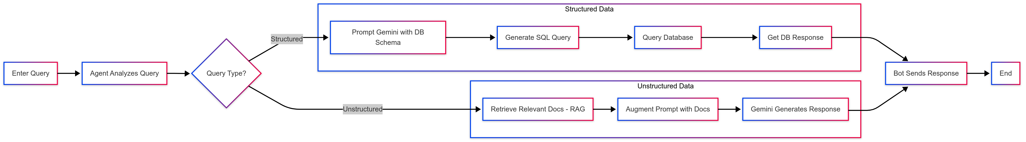
Flow

Slide 12
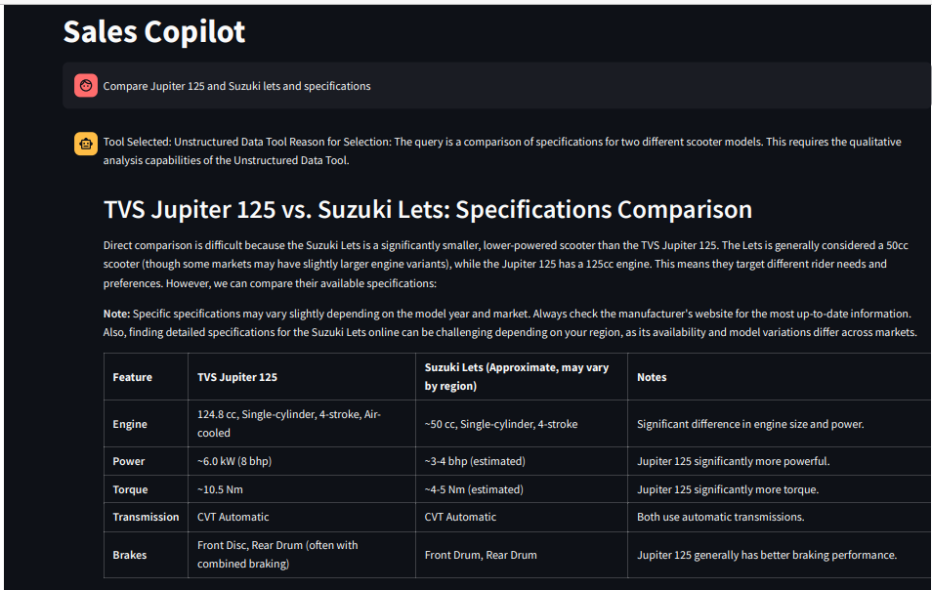
Example

Slide 13

Key Features: Handles both structured and unstructured data. ✔ Uses Langchain-Agents to determine which data to utilize. ✔ Employs PostgreSQL for structured data and Pinecone for vector storage. ✔ Built with Streamlit for the user interface. ✔ Utilizes Cohere embeddings and Pinecone for vector storage. ✔ Implements Retrieval-Augmented Generation (RAG) with Gemini Flash LLM

Slide 14
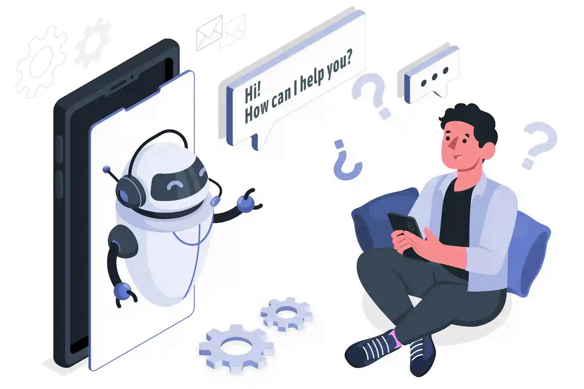
Project 2 – L0 Bot
Objective: Develop a chatbot to efficiently resolve user tickets.
In the support system, there are three teams: L1 (Support Team), L2 (Data Team),
and L3 (Technical Team). The challenge is that the L1 team receives a high volume
of queries, but due to a small team size, handling them efficiently becomes difficult.

Slide 15
AI-Powered Rule-Based Support Bot
Collects user details (Name, Email, Customer Type, Product) upon login
Asks for the issue faced by the user
Predicts incident type using a pre-trained Random Forest model
Three possible incident categories mapped to specific issues

Slide 16
Intelligent Issue Resolution
Key Flow:
Issue Classification – AI predicts incident type
Dynamic Questioning – LLM asks for additional details based on issue
AI Resolution (RAG-based) – Retrieves relevant solution steps from a Vector Database
User Choice:
If satisfied, ticket is marked as Resolved
If not, proceed to Live Agent

Slide 17
Seamless Live Agent Integration with Zendesk
If AI resolution is unsatisfactory, the bot creates a ticket
Ticket includes all collected details and a Queue Number is assigned
User waits in a queue for a Zendesk Live Agent
Once an agent is available, the user chats live to resolve the issue

Slide 18
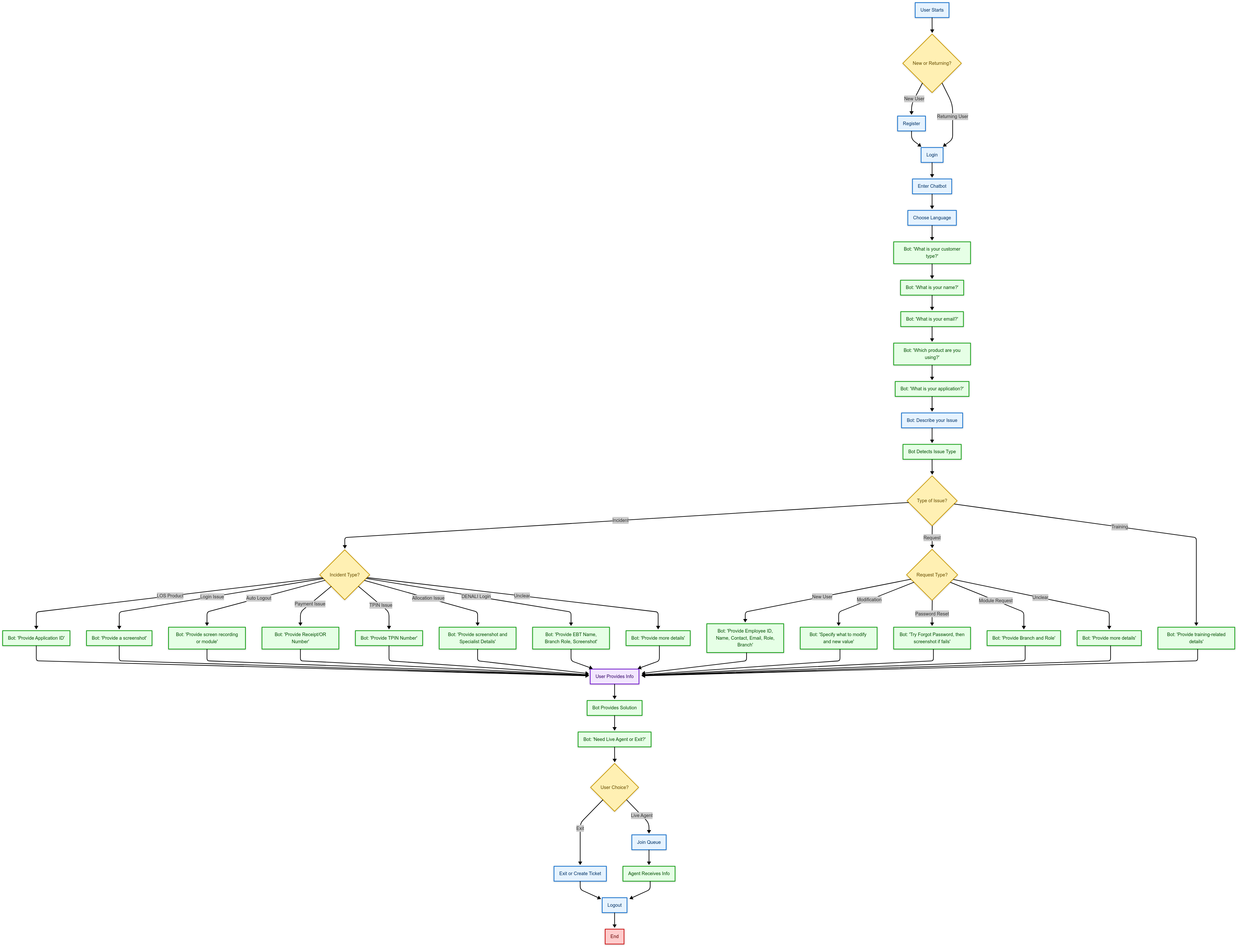
Flow

Slide 19
Key Features:
L0 bot designed to reduce the workload of the L1 bot.
Rule-based chatbot built using Flask.
Utilizes Cohere embeddings and Pinecone for vector storage.
Implements Retrieval-Augmented Generation (RAG) with Gemini Flash LLM.
Escalates complex cases to human agents when necessary.

Slide 20
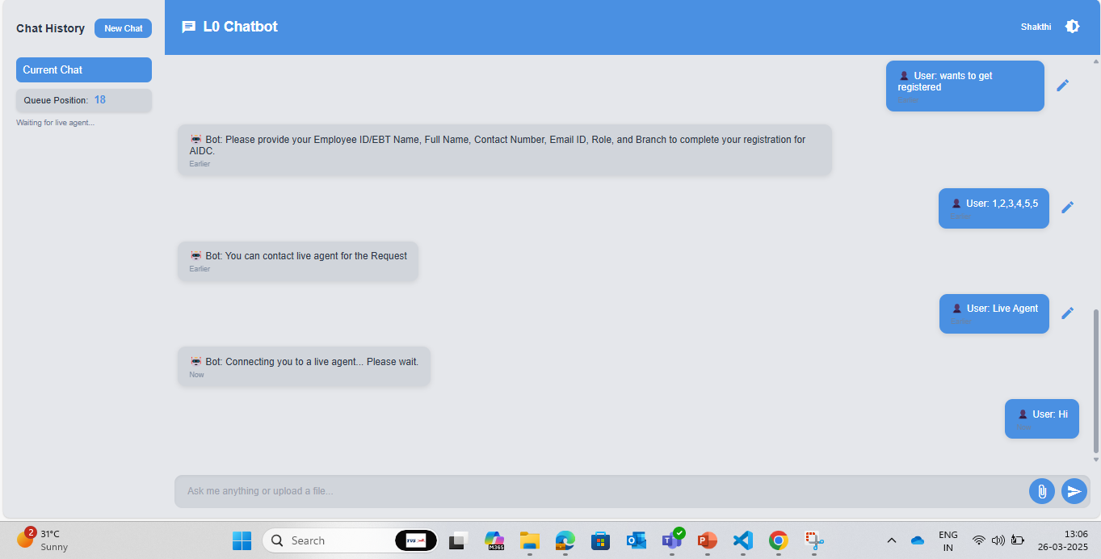

Slide 21
Timeline
Onboarding & Learning Phase
Began exploring LLMs, vector databases, and related technologies, and started working on their implementation.
Contributions and Future
• Currently working on a ticket creation chatbot.
• Planning to enable multilingual support in the future.
Jan 2025
Dec 2024
Feb 2025 & Beyond
Project Contributions
• Worked on the Sales Copilot, developed a Streamlit-based system, and successfully submitted it. As it is currently in the MVP stage, it will be utilized in the future.
• Began working on the second project.

Slide 22








Tools and Technology Used

Slide 23
Thank You

